Slide 1

UBC Library Research Commons
Getting Started with NVivo 2021

Slide 2
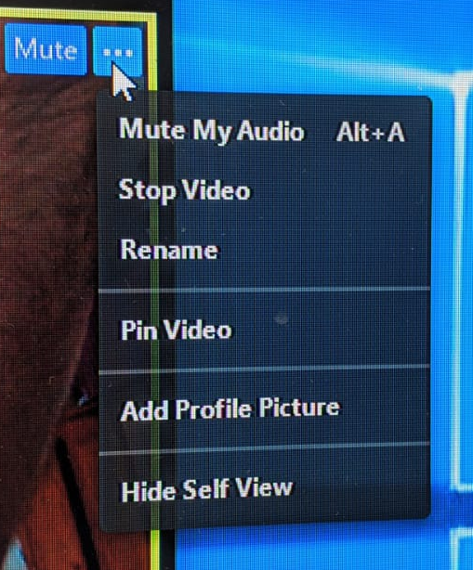
Add PC/MAC to Your Zoom Name
In order to direct you to the proper room—Mac or Windows—please change your name to include what version of NVivo you will be using:
Example:
Amir-Windows
Jeremy-Mac

Slide 3
Welcome to the Research Commons!
Workshops and One-on-one Consultations
Citation Management
R, SPSS
Data visualization
NVivo
…
Check the Website for more
Notes:
https://researchcommons.library.ubc.ca/nvivo-part-1-getting-started-with-nvivo/

Slide 4
Getting NVivo
UBC Library has NVivo on its computers (Room 217 and 218)
From Nov. 21, 2016, NVivo is available to UBC students, faculty and staff Instructions: https://it.ubc.ca/services/desktop-print-services/software-licensing/nvivo-pro-software
For new students, go to the following link (google- UBC On the Hub)
14-day free trial available to anyone at: http://www.qsrinternational.com/trial-nvivo

Slide 5
What do you think NVivo can do?
Zoom poll
Notes:
Quick poll:
NVivo can analyze my qualitative data for me.
NVivo can assist me in analyzing my data.

Slide 6
What is NVivo?
NVivo is a software package for computer-assisted qualitative data analysis (CAQDAS)
“that helps you easily organize and analyze unstructured information, so that you can ultimately make better decisions”
Source: QSR International
…and/or achieve better research outcomes!
Notes:
CAQDAS, Computer Assisted Qualitative Data Analysis Software is a term that refers to the wide range of software now available that supports a variety of analytic styles in qualitative work. Most of these programs have been under development for many years.
CAQDAS software does…
Structure work - Enables access to all parts of your project immediately,
'Closeness to data' interactivity - Instant access to source data files (e.g transcripts),
Explore data - Tools to search text for one word or a phrase,
Code and Retrieve Functionality - create codes and retrieve the coded sections of text,
Project Management and Data Organisation - Manage project and organise data,
Search and analyze the database - Search for relationships between codes,
Writing tools - Memos, comments and annotations,
Output - Reports to view a hard copy or export to another package.
The software does not..
Do the analytical thinking for you (though it can do things that help you do that thinking),
Do the coding for you. In general, you need to decide what can be coded in what way. Some software supports automatic coding the results of text searches, but it is still important to check what has been automatically coded. One program, Qualrus, after you have coded a passage, makes suggestions about how else you might code it. The same warning applies here. It is up to you to decide if what is suggested by the program makes sense.
Reduce bias, improve reliability or, on its own, improve the quality of your analysis (though it does have functions that can be used to help improve the quality of analysis),
Tell you how to analyse your data. (No-one thinks a word-processor can write a report for them.)
Does not calculate statistics, though some programs will produce simple counts and percentages

Slide 7

Learning Objectives
By the end of this session,
You will be able to import files
Save and backup your project
Create annotations and memos
Code your data into codes (parent and children codes)
Run basic queries

Slide 8
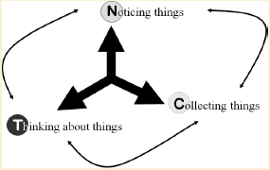
Qualitative Data Analysis (QDA)
The NCT model of qualitative data analysis adapted by Susanne Friese (2019) from Seidel (1998):
Thematic analysis
Grounded Theory
Content analysis
(Critical) Discourse Analysis
Conversation Analysis
etc.

Slide 9

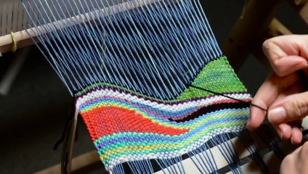
Constructing relationships in QDA
(Maxwell & Schmiel, 2013)
Similarity-based relations (categorizing strategies)
resemblances or common features; their identification is based on comparison, which can be independent of time and place. In qualitative data analysis, similarities and differences are generally used to define categories and to group and compare data by category.
‘How are they alike, and how are they different?’ (Smith, 1979)
Contiguity-based relations (connecting strategies)
juxtaposition in time and space, the influence of one thing on another, or relations among parts of a text; their identification involves seeing actual connections between things, rather than similarities and differences;
may also be identified among abstract concepts and categories, as a subsequent step to a categorizing analysis of the data.

Slide 10
Stages of a research project in NVivo
Stage | Processes
Literature Review | Collecting relationships, themes, findings and gaps
Research Design | Build audit trail Creating models
Data collection and analysis | Bringing together similar data (demographics, themes, concepts) Inductive / deductive Exploring data (queries) Linking data
Writing | Keeping track of ideas Visualizing Reporting
Notes:
We include this table to show you that you can work with Nvivo in different stages of your research project.
Literature reviews in NVivo – keeping everything in one place
Using NVivo for your literature review can be a great way to learn the software and get started with a project. You can bring in your journal articles and:
Organize them in a source folder called ‘Literature’.
Code each article to gather material by theme—you might also want to make nodes for ‘statistics’, ‘good quotes’ and ‘definitions’.
Annotate as you read, marking content for follow-up or further exploration.
Use memos to describe the key themes and critique the articles.
Use source classifications to assign attributes like publication date and author (you can also import these from reference management software like Endnote). Then use queries to find everything an author wrote about a theme or everything that was written before a certain date.
Use a Word Frequency query to see what common terms are being used.
Use a Matrix Coding query to find gaps in the literature—what themes

Slide 11
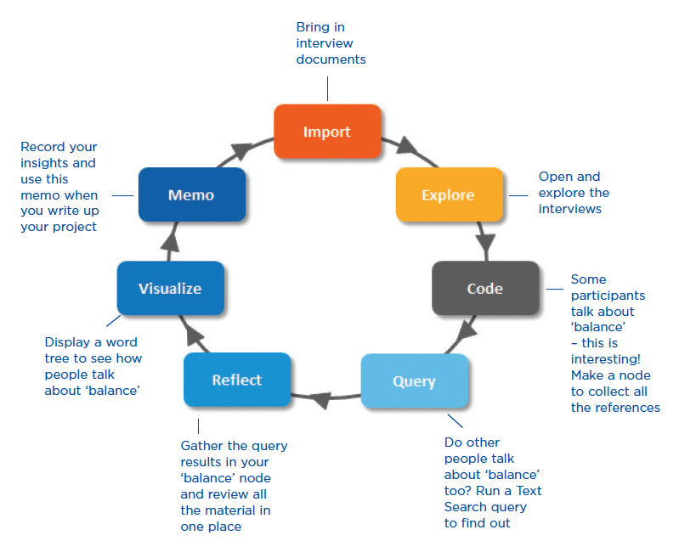
How do I approach my research project?
Qualitative data analysis -- including in NVivo -- is characteristically
non-linear, emergent, iterative, and reflexive.
(Silver & Lewins, 2014)
Notes:
Reflexive in the sense of ongoing reflection on your analysis but also consideration of your positionality and its implications for the direction the analysis is taking.
Nvivo can help you to manage, explore and find patterns in your data but it cannot replace the analytical expertise.
NVivo does not favor a particular methodology –it is designed to facilitate common qualitative techniques.
Some researchers adopt a qualitative methodology to suit their research question. For example, a social scientist wanting to develop new concepts or hypotheses may take a ‘grounded theory’ approach. A health researcher looking for ways to improve policy or program design might use ‘evaluation methods’. NVivo doesn’t favour a particular methodology — it’s designed to facilitate common qualitative techniques for organizing, analyzing and sharing data — no matter what method you use.

Slide 12
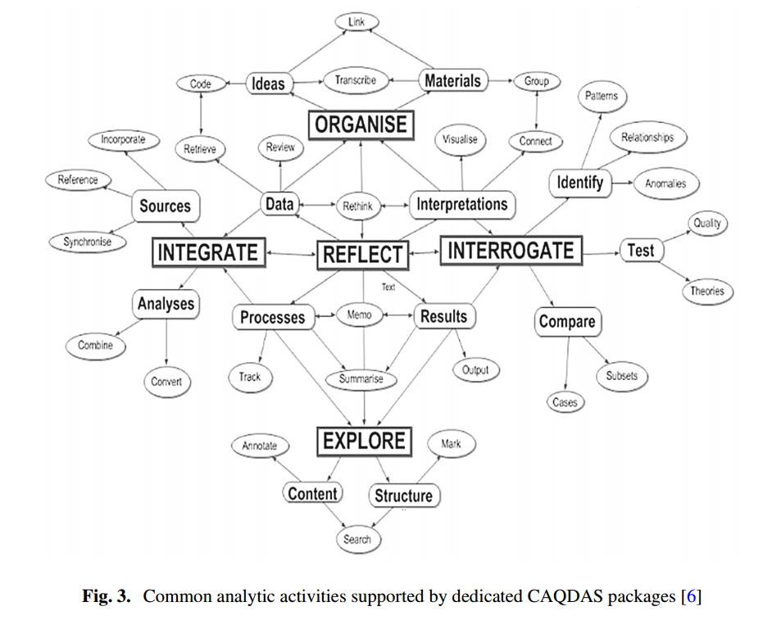



























(Silver & Lewins, 2014; Silver, 2018)

Slide 13
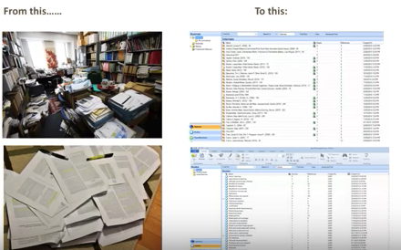
Organizing Qualitative Data
Notes:
If we compare these two different images, we can see the difference between trying to organize unstructured information manually or using a software like Nvivo. (You can benefit for once in the amount of space you need: an office compare to a screen)
Many qualitative researchers are interested in evaluating, interpreting and explaining social phenomena. They analyze unstructured or semi-structured data like interviews, surveys, field notes, web pages and journal articles — and they work in a range of sectors; from social science and education to healthcare and business.
Qualitative data analysis software, such as NVivo, can help you organise and analyse qualitative data more effectively.

Slide 14
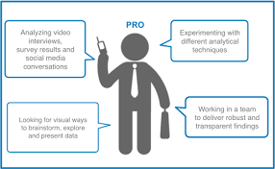
Benefits
Analyze multiple data types and sources productively
Experiment with analytical techniques that are difficult to conduct manually
Work in a team to increase robustness
Visualize to brainstorm and to present data
Notes:
Transparency and rigor in qualitative analysis – This allows for group projects to code in the same manner across the project and allows others to see the changes that have been made so that each member of the team knows the what and why of
MS Word-like environment
Data organization
Single project file that can be easily transported and shared with others
Memos, annotations and links –
Memos are an integral part of the research process — and can be a great starting point when you come to writing-up your project. You can use memos to tell the story of your project — from your early ideas and assumptions to fully-fledged insights about a topic, person, or event. Use them to ‘talk to yourself’ as you make sense of your data.
Tracking your analytical process with memos can help you to increase the transparency and reliability of your findings. With your process recorded in memos, you can easily demonstrate the evolution of a theory or quickly call up data that supports client questions. Memos like documents and they can be linked to sources or nodes.
Annotations are like scribbled notes in the margin—they let you record comments, reminders or observations about specific content in a source or node.
Use ‘see also’ links to draw connections between items in your project. For example, you can use ‘see also’ links to point out contradictions, follow evidence or show a sequence of events.

Slide 15
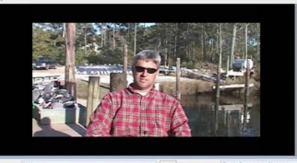
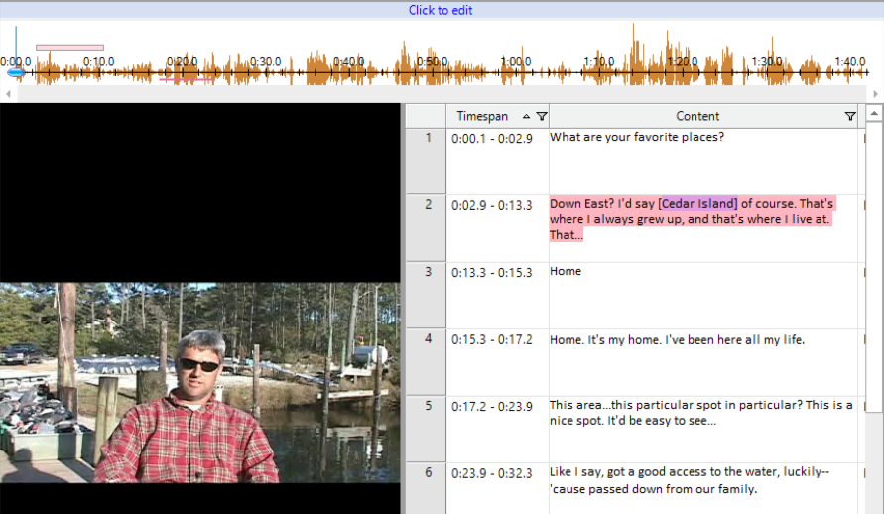
Built-in transcription capabilities
Audio or Video file
Transcribe in NVivo
Text
Notes:
Creating your own transcripts may bring you closer to your data but it can also be labor intensive and time consuming. Instead, you can have your media files professionally transcribed using TranscribeMe— But you will be able to all the transcription that you would like inside of the NVivo Program.

Slide 16
Cautions
NVivo can’t tell you what or how to analyze! It’s a translation process from analytic tasks to software tasks (Woolf & Silver, 2017).
PC and Mac are becoming more similar, but PC still has more features than Mac version
Proprietary software (if you’re thinking about the future)
Notes:
Big contrast between software tools (that are fixed and prearranged) and qualitative analysis (which is iterative and emergent)

Slide 17
Task 1
Download sample interview transcripts from RC website.
Open NVivo.
Open a new blank project: Give it a name and a description.
Import the interview with Barbara.
Check out the software interface.
Notes:
https://researchcommons.library.ubc.ca/nvivo-part-1-getting-started-with-nvivo/

Slide 18
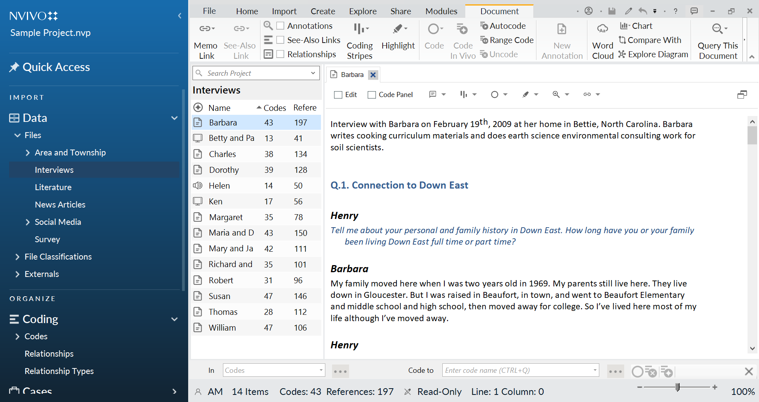
General: Software screenshot
Navigation view
List view
Detail view
Notes:
This image is a screenshot of NVivo after adding a few sources and double clicking on one of the internals sources to view the details that contain.
Here you can see that the NVivo workspace provides easy access to all your project materials.
The ribbon helps you locate all Nvivo commands.
Navigation Views lets you organize your materials into folders.
The contents of the folders are showed in the List View.
And you can work with your sources, nodes or other project items in Detail View.
Explain the main menu is composed by: sources, nodes, classifications, collections, queries, reports, maps and folders.
In order to work with the program you will open one of this folder and in the navigation view it will appear the detail of what is contained in each folder.
different views: navigation, list and detail view.

Slide 19
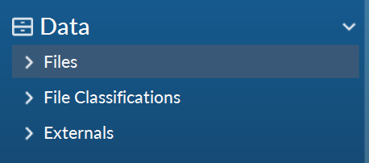
DATA
Files
File Classifications
Externals
Notes:
Transition Slide
Sources are were you are going to storage all your research materials including documents. PDFs, datasets, audio, video, pictures, memos and framework matrices.

Slide 20
Files
Supports file types
Audio (.mp3, .m4a, .wma, .wav)
Video (.MPEG, .mp4, .avi, .wmv, .mov, etc.)
Pictures (.bmp, .gif, .jpg, .png, .tiff)
Documents (.docx, .doc, .rtf, .txt)
Datasets (.xlsx, .xls, .txt, SurveyMonkey, Qualtrics)
PDFs (Smart PDFs are best, though!)
Information from websites/social media (via NCapture)
Notes:
Internals – This is any source that you can upload into NVivo

Slide 21
Files Classifications
File classifications also allow you to capture general information about your files—for example, date of publication, issue, volume.
If you conduct a literature review, you can import the literature references into NVivo—the bibliographical data is stored using 'file classifications'.
Notes:
Internals – This is any source that you can upload into NVivo

Slide 22
Externals
Externals are ‘proxies’ for the material you cannot import into NVivo
Books
Physical artifacts
Externals appear as documents with a content summary of the original source
Notes:
Externals are ‘proxies’ for the material you cannot import into NVivo such as books, or physical artifacts.
You can create an external source (that looks like a document) and summarize the content of the item—for example, you might summarize the chapters in a book.

Slide 23
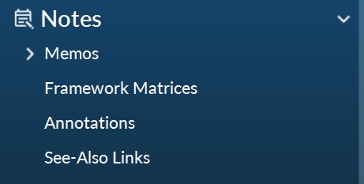
Notes
What can you do with them?
Memos
Framework Matrices (PC only)
Annotations
See Also Links
Notes:
Transition Slide
Notes is the place where you are going to store all your research materials including documents. PDFs, datasets, audio, video, pictures, memos and framework matrices.

Slide 24
Memos
Memos are like documents and they can be linked to sources or nodes.
Tell the story of your project
Talk to yourself as you make sense of your data
Track your analytical process
Notes:
Memos are an integral part of the research process—and can be a great starting point when you come to writing-up your project. You can use memos to tell the story of your project—from your early ideas and assumptions to fully-fledged insights about a topic, person, or event. Use them to ‘talk to yourself’ as you make sense of your data.
Tracking your analytical process with memos can help you to increase the transparency and reliability of your findings. With your process recorded in memos, you can easily demonstrate the evolution of a theory or quickly call up data that supports client questions. Memos like documents and they can be linked to sources or nodes.

Slide 25
Task 2
Open Barbara’s transcript:
annotate
create a memo
Notice the difference?

Slide 26
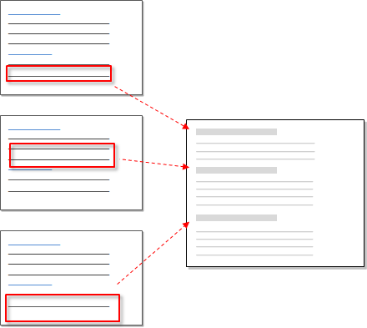
Coding
'Coding' your sources is a way of gathering all the references to a specific topic, theme, person or other entity. You can code all types of sources and bring the references together in a single 'node’
code=node
Source: QSR International
Notes:
On the scheme (refer to the previous slide): the source would be the 3 docs on the left, the references (~quotes) would be the boxes highlighted in red
'Coding' your sources is a way of gathering all the references to a specific topic, theme, person or other entity. You can code all types of sources and bring the references together in a single 'node’
The most important part of coding is ensuring that NVivo has something to read. You can have a variety of sources: Documents, Pictures, Videos, and websites. But the most important thing is to ensure that each source has text that can be read. In the case of pictures you will have to add captions, videos will need to be transcribed and you will need to ensure that you have smart PDF’s or that you have added notes or annotations so that you are able to code into a node.
The way you approach coding depends on your methodology and research design but here are some ideas to get started:
Start with ‘broad-brush’ coding to organize the material into broad topic areas (you can use Text Search queries to help with this)—then explore the node for each topic and do more detailed coding. For example, gather all the content about water quality and then explore the node looking for interesting perceptions, contradictions or assumptions.
Or, you could get straight into detailed coding (making nodes as you need them) and then, later on, combine and group your nodes into related categories.
As you reflect on a piece of content, think about these different types of coding:
• Topic coding—What is the topic being discussed? For example, water quality, real estate development, tourism and so on.
• Analytical coding—What is this content really about? Why is it interesting? Consider the meaning in context and express new ideas about the data. For example, ideals vs reality, tension between developers and residents.
• Descriptive or ‘case’ coding— Who is speaking? What place, organization or other entity is being observed?

Slide 27
Task 3
Code sections of the interview with Barbara.
See coded sections using Coding Stripes.
Explore multiple technical ways of coding.

Slide 28
Coding
Definition: A code in qualitative inquiry is most often a word or short phrase that symbolically assigns a summative, salient, essence-capturing, and/or evocative attribute for a position of language-based or visual data. (Saldaña, 2016)
Categorizing and connecting strategies (Maxwell & Miller, 2008).
It can be done in cycles – First(s) & Second(s).
in vivo coding, emotion coding, values coding, etc.
You can create sub-codes
You can apply multiple codes for a given segment.
You can (or must) write memos as you annotate and/or code.
Your RQs are your guides.
A useful, meaningful codes will have a label, a definition, and examples (Right Click -> Get Info/ Code Properties) (Boyatzis, 1998, p. 3)

Slide 29
Useful, meaningful codes, will have:
A label (i.e., name)
A definition of what the code contains (i.e., the characteristic or issue constituting the code)
Examples, to eliminate possible confusion when retrieving the code.
(Boyatzis, 1998, p.31)

Slide 30
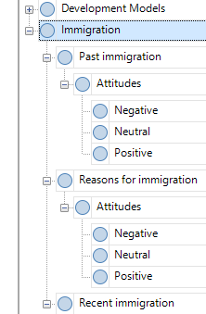
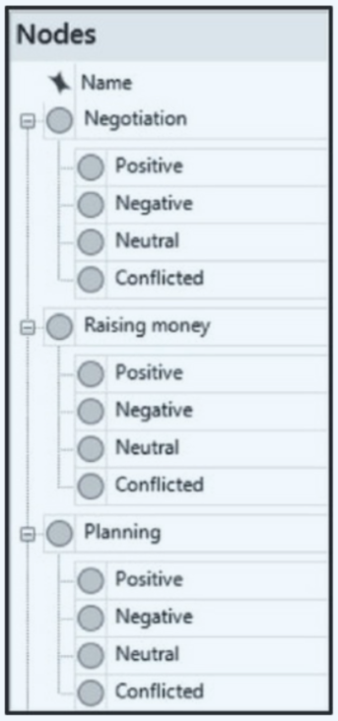
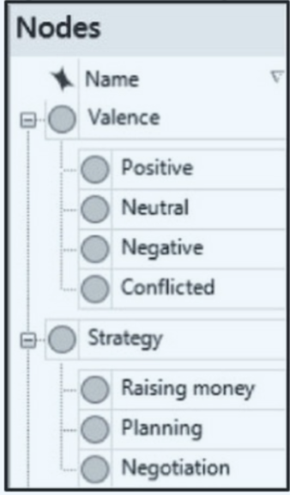
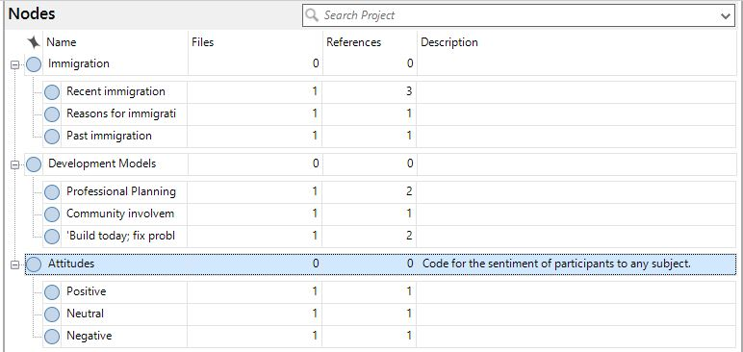
d
Nodes in NVivo
Mixing ‘families’ / Viral coding
Separating ‘families’ (children types of parents) / Vista coding
Too many codes
Less flexibility for asking questions
Mixing up categories
Impose results before analysis
Time consuming
Necessitates remembering all the codes you need to apply
Keep track of possible queries in Memos.
Thorough definition of categories
Maintaining contexts (seeing nesting)
Immediate impression readings
Ad-hoc coding (less effort on categorization)
You don’t use Queries
Less nodes
More flexibility for asking questions (not foreseen)
Clarity and systematicity
Blinding effect

Slide 31
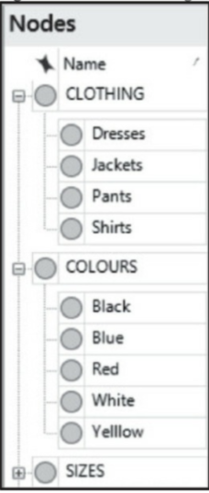
Examples of categories
Actions – things that are done at a point in time (e.g., Argue, Cheer, Laugh, Listen).
Activities – ongoing actions (e.g., Aging, Learning, Raising children, Supervising).
Beliefs, ideological positions, frameworks – intellectual positions (or discourses) which are evident in thinking and action (e.g., Honesty, Independence, Reason, Spirituality).
Context – the settings in which actions, events, etc. occur (e.g., Adolescence, Downtown, School, Work).
Culture – social behaviours and norms that are likely to have multiple sub-branches, depending on the type of culture (e.g., Art, Careers, Kinship, Technology).
Emotions – feelings (e.g., Anticipation, Gratitude, Joy, Sorrow).
Events – highly structured actions or rituals (e.g., Birthday parties, Recitals, Weddings, Vacations).
Issues – matters raised about which there might be some debate (e.g., Control, Ownership, Privacy, Transparency).

Slide 32
Examples of categories
Narrative –narrative features (e.g., Contradictions, Omissions, Pronouns, Repairs).
People (or actors or entities) that are referred to or talked about – the locus or target of a comment, either specifically (e.g., Dr. Almos or My boss) or generally (e.g., Employees, Managers, Nurses, The industry).
Valences (also sometimes called sentiments or attitudes) – the participant’s implicit or explicit response to a topic (e.g., a participant says or implies they are Conflicted, Negative, Positive, or Uncertain about an event or action; or identify it as a Barrier or Facilitator to success).
Strategies – a purposeful activity to achieve a goal or deal with an issue (e.g., Making amends, Negotiating, Planning, Raising money).
(Jackson & Bazeley, 2019)

Slide 33
Examples useful (non-hierarchical) codes
Good quotes – an area to store References that are especially compelling, poignant, or typical. These can be cross-referenced with your other Nodes with a Coding Query to find the quotes that pertain to a particular concept or theme to assist you in writing up your findings (but be careful about cherry picking your findings just because of these quotes).
Suggestions – to capture the recommendations provided by participants about how things could or should be done or changed.
Retired Nodes – to store any defunct concepts or themes in case you are not fully convinced you want to delete them.
(Jackson & Bazeley, 2019)

Slide 34
How much is enough?
If only a few changes and adjustments need to be made – that is, you mostly apply already existing tags, no new properties are emerging and the existing ones are filling with content – you approach theoretical saturation.
(Friese et al., 2016, p. 19 ; Richards, 2015)

Slide 35
Nodes in NVivo
Notes:
This is what a node looks like in NVivo. Explain what we are looking at and what parent and child nodes are.
Explain the difference between files and references – ask if the students can guess it first?
Remember to describe your codes in their properties in order to be able to reviews your coding strategies and transfer the codes more easily when working with your team.

Slide 36
d
Nodes in NVivo
Mixing ‘families’ / Viral coding
Separating ‘families’ (children types of parents) / Vista coding

Slide 37
Task 4
Open Sample project.
Explore the codes and their structure.
Change the hierarchical structure (move codes from top level to sub-level and vice versa.
Aggregate / disaggregate
Notes:
Split into breakout groups last time – for

Slide 38
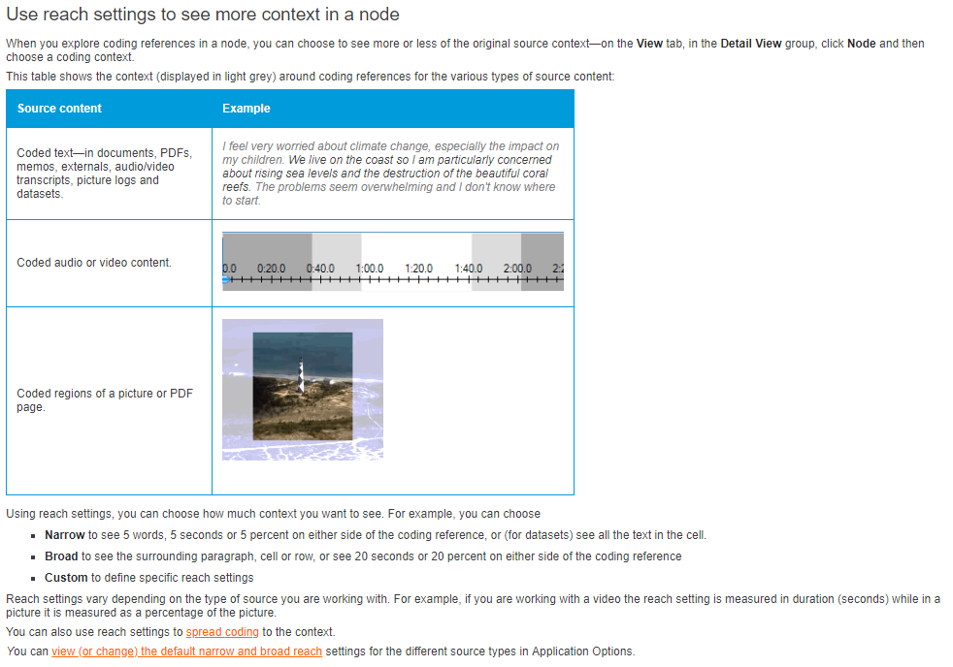

Slide 39
Query
What do you think a query is?
What is it for?

Slide 40
What is a query?
Find and analyze words or phrases in your sources, annotations and nodes
Ask questions and find patterns based on your coding and check for coding consistency among team members
Code and/or visualize the results
Source: QSR International
Notes:
Queries provide a flexible way to gather and explore subsets of your data. In NVivo, you can create queries to
Find and analyze the words or phrases in your sources, annotations and nodes. You can find specific words or those that occur most frequently.
Ask questions and find patterns based on your coding and check for coding consistency among team members
Making the most of your queries
Start running queries early on in the coding process—they can help you focus on the questions you want to ask (and prompt you to code accordingly). For example, if you want to ask “How serious are the issues of water quality for local fishermen?”—make sure you code at the node for water quality and code at case nodes with the fisherman attribute.
Use coding queries to build-up and test ideas. For example, you have a hunch that people’s perception of water quality is closely tied to the pace of development. Create a query to gather all material coded at water quality where it is NEAR content coded at ‘development’.
Make a memo to record what you learn from a query—this can prompt you to ask further questions and facilitate deeper analysis. Link the memo to the query results.

Slide 41
Queries we will cover today
Text search & word frequency
Matrix
Crosstab
Coding
Interrater agreement(?)
?

Slide 42
Task 5
Run frequency queries
Create a word cloud (explore some of the words inside)
Save the query
Run text search queries (based upon the frequency query)
Create nodes from your queries

Slide 43
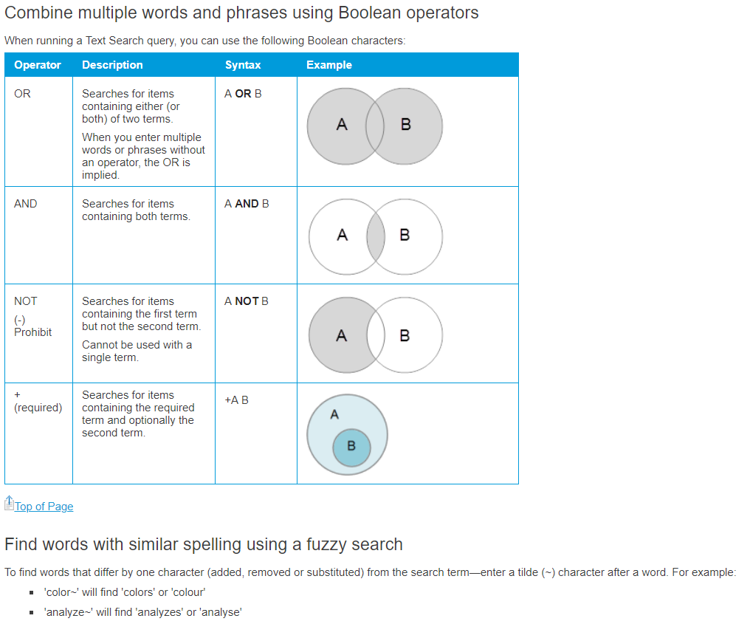

Slide 44
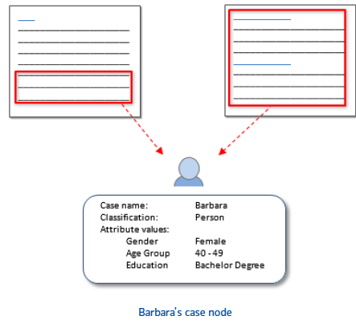
Cases
Cases are the 'units of observation' in your research study. They might represent people, places, events, organizations or other entities that you want to analyze and compare.
(NVIVO website)
Notes:
Cases: Just like thematic nodes, cases are containers to hold specific information, you use cases to represent the significant entities in your research. But unlike thematic nodes, cases allow you to integrate specific details for the information they contain, for example as a person (demographic information), location and add attributes for each particular descriptor.
For example, if you have created nodes for interview respondents and classified them as Person, you can double-click on the classification to quickly see the spread of your respondents.
Why code at nodes for themes and cases? Means you can answer questions with different criteria.

Slide 45
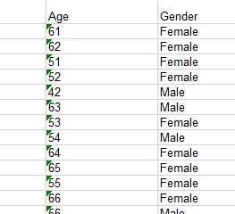
Attributes and Values
(close-ended questions by nature -> turn to Attributes)
Attribute: a type of quality, character, or characteristic ascribed to someone or something.
Value: the specific quality, character or characteristic ascribed…

Slide 46
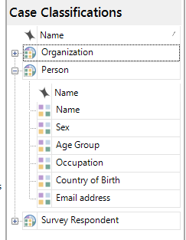
Case classifications
Allow users to record descriptive information about people, places, organizations, or other ‘classifications’ in a project.
Case classification
Add attributes manually or use automatic template from NVIVO (different processes)
Attributes
Attribute
Case
Values
Notes:
**Use classifications to record descriptive information, like demographic details, about the cases in your project.
IN the image, we are seeing the example of creating classifications for each of the cases that have been created for the project (based on the intreviews)
You can use ‘node classifications’ to capture the demographic details of the people, places or other cases in your project. For example, if you have interviewed people in a particular community, you may want to collect information about their age, gender and occupation—and compare their responses based on these attributes. There are only 3 predefined Node Classifications inside NVivo for PC.
You can setup demographic data in NVivo or you can import it from a spreadsheet or text file.
Predefined classifications come with a set of attributes—for example, Person has attributes for age, occupation and so on. Custom classifications do not have default attributes but you can add your own.

Slide 47
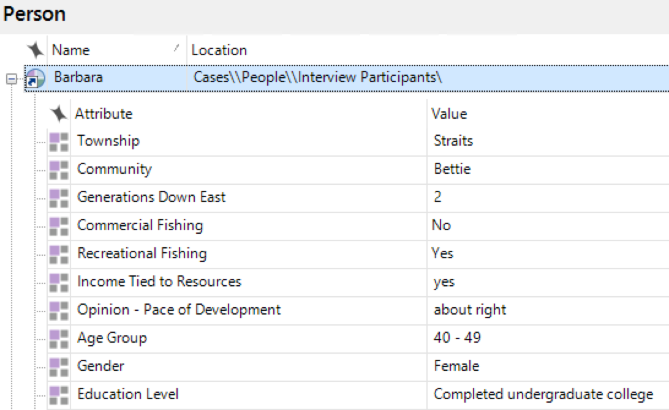
All together now
Case classification
Case
Attributes
Values
Notes:
EXPLAIN THAT FOR ‘PERSON’ AND ‘ORGANIZATION’ YOU GET AUTOMATIC ATTRIBUTES (TEMPLATE OF)

Slide 48
Coding comparison query
A Coding Comparison query enables you to compare coding done by two users or two groups of users.
Coding comparison takes into account not only the content which was coded by both users, but also the content which was not coded by both users.
If the two users are in complete agreement about which content of the file should be coded at the node, then the Kappa coefficient is 1. If there is no agreement between the two users (other than what could be expected by chance), the Kappa coefficient is ≤ 0. A value between 0 and 1 indicates partial agreement.
Source: QSR International
Notes:
Queries provide a flexible way to gather and explore subsets of your data. In NVivo, you can create queries to
Find and analyze the words or phrases in your sources, annotations and nodes. You can find specific words or those that occur most frequently.
Ask questions and find patterns based on your coding and check for coding consistency among team members
Making the most of your queries
Start running queries early on in the coding process—they can help you focus on the questions you want to ask (and prompt you to code accordingly). For example, if you want to ask “How serious are the issues of water quality for local fishermen?”—make sure you code at the node for water quality and code at case nodes with the fisherman attribute.
Use coding queries to build-up and test ideas. For example, you have a hunch that people’s perception of water quality is closely tied to the pace of development. Create a query to gather all material coded at water quality where it is NEAR content coded at ‘development’.
Make a memo to record what you learn from a query—this can prompt you to ask further questions and facilitate deeper analysis. Link the memo to the query results.

Slide 49
Coding comparison query
Unweighted Values Files are treated equally (regardless of size) when calculating the overall results for each node.
Weighted Values File size is taken into account when calculating the overall results for each node. File Size is the characters, sentences or paragraphs, depending on the options chosen in the query criteria. For example, a document with 1000 paragraphs would contribute more to the overall results than a document with only 20 paragraphs.
Source: QSR International
Notes:
Queries provide a flexible way to gather and explore subsets of your data. In NVivo, you can create queries to
Find and analyze the words or phrases in your sources, annotations and nodes. You can find specific words or those that occur most frequently.
Ask questions and find patterns based on your coding and check for coding consistency among team members
Making the most of your queries
Start running queries early on in the coding process—they can help you focus on the questions you want to ask (and prompt you to code accordingly). For example, if you want to ask “How serious are the issues of water quality for local fishermen?”—make sure you code at the node for water quality and code at case nodes with the fisherman attribute.
Use coding queries to build-up and test ideas. For example, you have a hunch that people’s perception of water quality is closely tied to the pace of development. Create a query to gather all material coded at water quality where it is NEAR content coded at ‘development’.
Make a memo to record what you learn from a query—this can prompt you to ask further questions and facilitate deeper analysis. Link the memo to the query results.

Slide 50
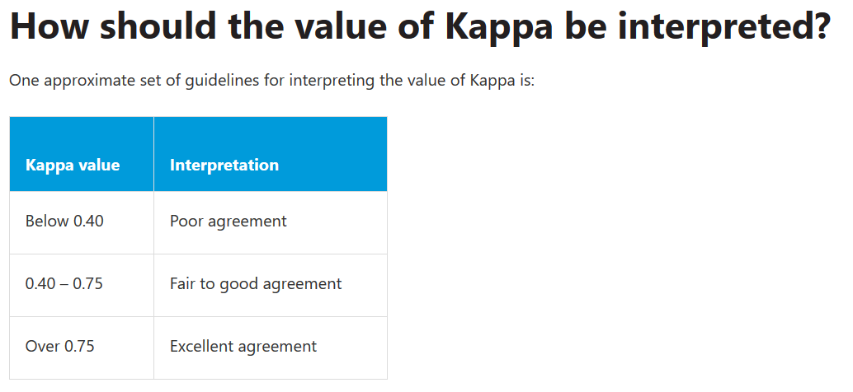
Coding comparison query
Source: QSR International
Notes:
Queries provide a flexible way to gather and explore subsets of your data. In NVivo, you can create queries to
Find and analyze the words or phrases in your sources, annotations and nodes. You can find specific words or those that occur most frequently.
Ask questions and find patterns based on your coding and check for coding consistency among team members
Making the most of your queries
Start running queries early on in the coding process—they can help you focus on the questions you want to ask (and prompt you to code accordingly). For example, if you want to ask “How serious are the issues of water quality for local fishermen?”—make sure you code at the node for water quality and code at case nodes with the fisherman attribute.
Use coding queries to build-up and test ideas. For example, you have a hunch that people’s perception of water quality is closely tied to the pace of development. Create a query to gather all material coded at water quality where it is NEAR content coded at ‘development’.
Make a memo to record what you learn from a query—this can prompt you to ask further questions and facilitate deeper analysis. Link the memo to the query results.

Slide 51
Coding comparison query
Why is my Kappa low?
Because the Kappa coefficient calculation takes into account the likelihood of the agreement between users occurring by chance, the value of Kappa can be low even though the percentage agreement is high.
Coding comparison takes into account not only the content which was coded by both users, but also the content which was not coded by both users.
This is why many researchers regard the Kappa coefficient as a more useful measure of inter-rater reliability than the percentage agreement figure.
Source: QSR International
Notes:
For example, if most of a file has not been coded at the node by either user, but each user has coded completely different small sections of the file at the node, then the percentage agreement between the users will be high. But since this situation would be highly likely to occur by chance (i.e. if the two users had each coded a small section at random), the Kappa coefficient is low.
Conversely, if most of a file has not been coded at the node by either user, but each user has coded almost the same sections of the file at the node, then the percentage agreement between the users will again be high. But this situation would be highly unlikely to occur by chance, so the Kappa coefficient is also high.

Slide 52
Coding comparison query
What does a negative Kappa coefficient mean?
A Kappa coefficient less than or equal to zero indicates that there is no agreement between the two users (other than what could be expected by chance) on which content in the file may be coded at the node.
Source: QSR International
Notes:
For example, if most of a file has not been coded at the node by either user, but each user has coded completely different small sections of the file at the node, then the percentage agreement between the users will be high. But since this situation would be highly likely to occur by chance (i.e. if the two users had each coded a small section at random), the Kappa coefficient is low.
Conversely, if most of a file has not been coded at the node by either user, but each user has coded almost the same sections of the file at the node, then the percentage agreement between the users will again be high. But this situation would be highly unlikely to occur by chance, so the Kappa coefficient is also high.

Slide 53
Coding comparison query
What does a negative Kappa coefficient mean?
A Kappa coefficient less than or equal to zero indicates that there is no agreement between the two users (other than what could be expected by chance) on which content in the file may be coded at the node.
All my Kappa coefficients are 0 or 1. Is something wrong? This most often indicates that one of the two users being compared has not coded any of the selected files at the selected nodes.
Source: QSR International
Notes:
For example, if most of a file has not been coded at the node by either user, but each user has coded completely different small sections of the file at the node, then the percentage agreement between the users will be high. But since this situation would be highly likely to occur by chance (i.e. if the two users had each coded a small section at random), the Kappa coefficient is low.
Conversely, if most of a file has not been coded at the node by either user, but each user has coded almost the same sections of the file at the node, then the percentage agreement between the users will again be high. But this situation would be highly unlikely to occur by chance, so the Kappa coefficient is also high.

Slide 54
Task 6
Open the Sample Project.
Run a Coding Comparison query.

Slide 55
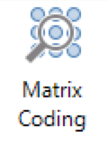
Matrix coding queries
Finds a combination of items (usually nodes or cases and attributes) and displays the results in an interactive table.
Allows you to ask a wide range of questions about patterns in the data and gain access to the content that shows those patterns.
Check how often interview respondents (case/s) refer to a particular topic or issue (node/s)
Check how many female and male respondents (attribute/s) refer to a topic or theme (node/s)
Code(s) X Code(s)
Code(s) X Attributes
Code(s) X Cases
Codes(s) X Files
…
…
…

Slide 56
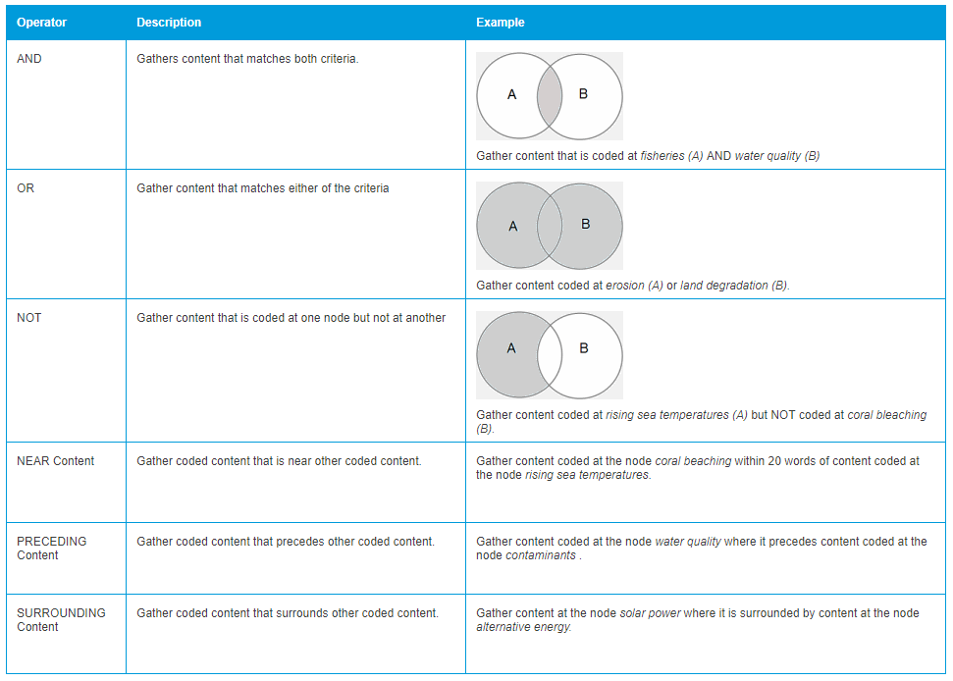

Slide 57
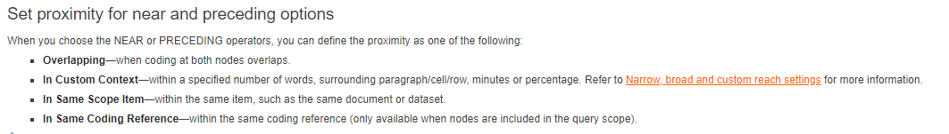
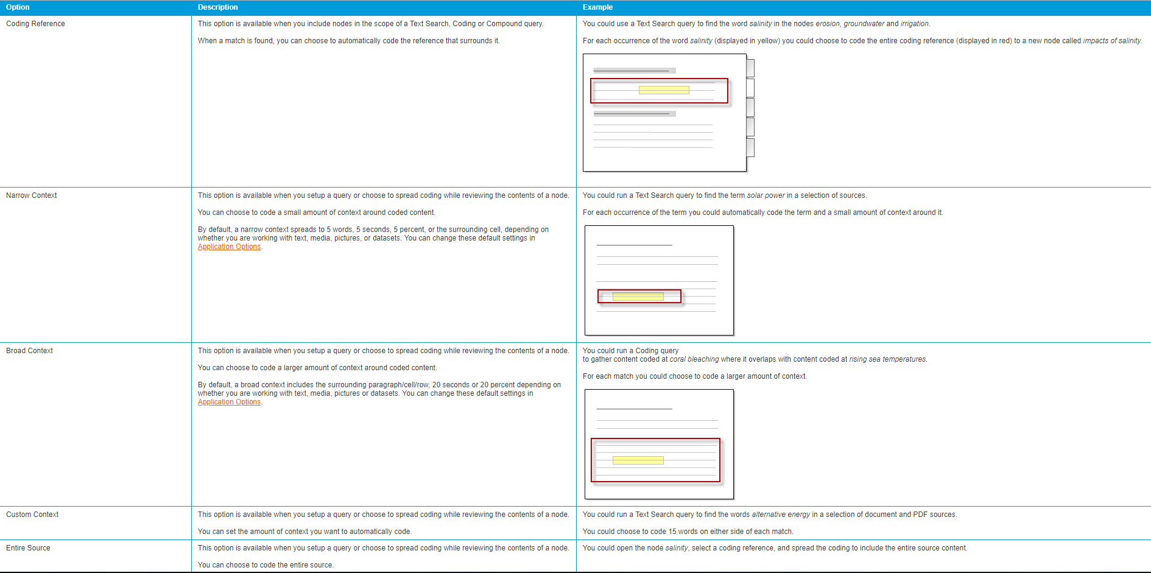

Slide 58
Task 6
Close NVIVO and re-open it.
Create a Sample Project.
Run Matrix queries
What findings did you find?

Slide 59
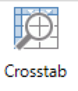
Crosstab queries
Adds a 2nd layer (attribute within an attribute)
Quicker and friendlier
For example:
Check how coding is distributed across the cases, or different types of cases in your project
Check how often female and male interview respondents with different educational levels refer to a particular topic or issue (node/s).
(sub attribute=gender)
(main attribute=educational level)

Slide 60
Task 7
In the Sample Project:
Run Cross-tab queries
What results did you find?

Slide 61
Additional queries
Word frequency
Text search
Notes:
(Transition Slide Agenda for the up coming slides.)

Slide 62
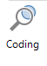
Coding queries
Ask any question and immediately get references (no tables).
Get all the references of female participants (attribute/s=gender, value/s=female) that relate to a particular topic or issue (node/s).
You can use more than one node or attribute or case…

Slide 63
Task 8
In the Sample Project:
Run a coding query!
Learn how to find a reference in its original context.
What findings did you find?

Slide 64
NVIVO and Reference Managers
You can import references from your reference manager:
Refworks, Mendeley, Zotero, Endnote (xml, ris, txt)
Import notes, files (depending on the export)
Create attributes for: Author, Year, etc. (notes are imported as Memos)
Run queries:
How often was a topic discussed in the 90s as opposed to the 2000s?
.

Slide 65
Task 8
Open sample project TestIntermediate.
Explore the Lit review coding.
Import the .ris file.

Slide 66
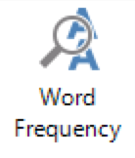
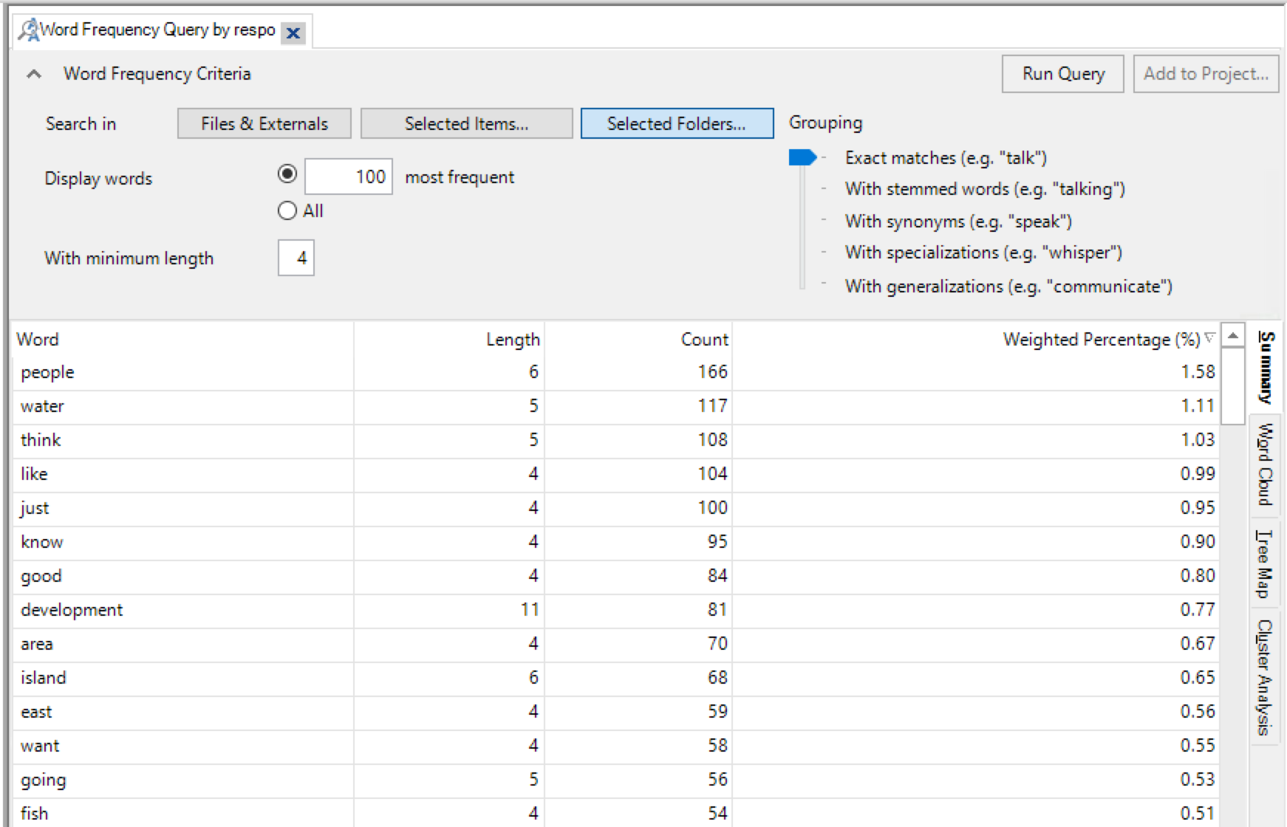
Word frequency queries

Slide 67
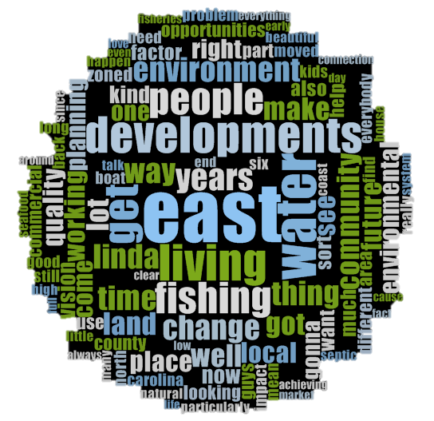
Word Cloud
Notes:
14 species described
Word frequency queries list the most frequently occurring words in your sources and visualize the results in a word cloud, tree map or cluster analysis diagram:
Display results in a word cloud, double-click a word to gather all occurrences

Slide 68
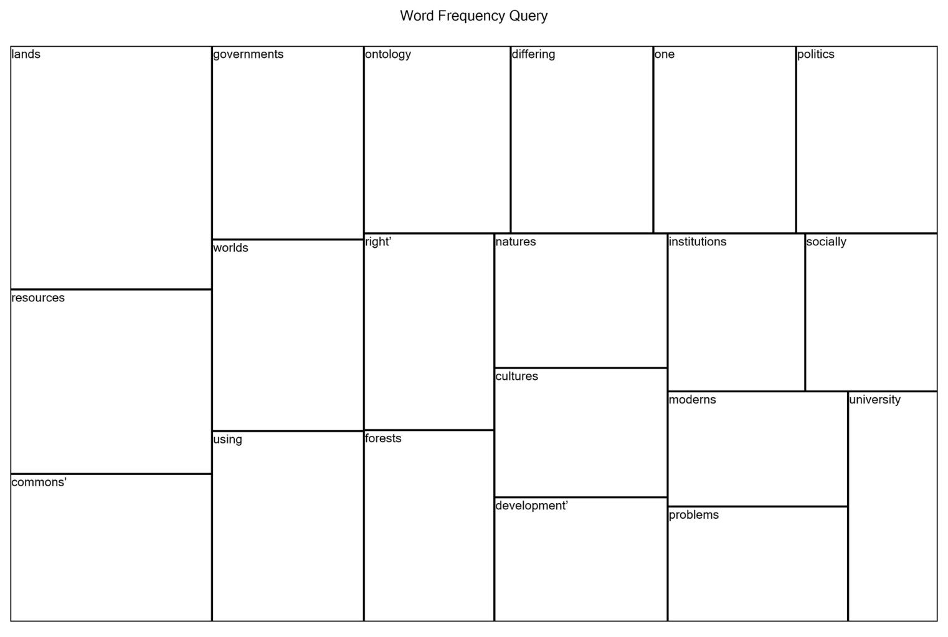
Tree Map
Notes:
You can use other visualization techniques to get a different perspective on what is happening in your data—for example:
Use a tree map to compare nodes by the number of references they contain: See patterns of coding in your project, or compare sources or nodes based on their attribute values

Slide 69
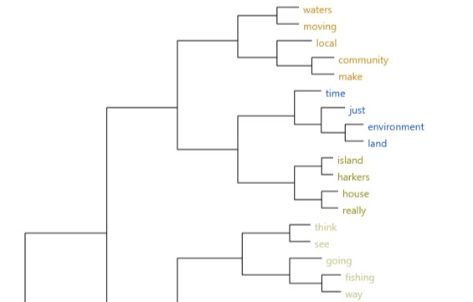
Cluster Analysis (Horizontal Dendrogram)
Notes:
Use cluster analysis to group sources or nodes that share similar words, attribute values, or coding:
As you work with sources, nodes or query results you can choose to visualize the data. For example, you can display a cluster analysis diagram for a social media dataset or display a tag cloud for the results of a Word Frequency query.
A horizontal branching diagram where similar items are clustered together on the same branch and different items are further apart.
Dendrograms can be useful for comparing pairs of items.
Cluster analysis allows you to visualize similarities between items. The closer the items are the more related they are, the more they have in common (co-occurences).

Slide 70
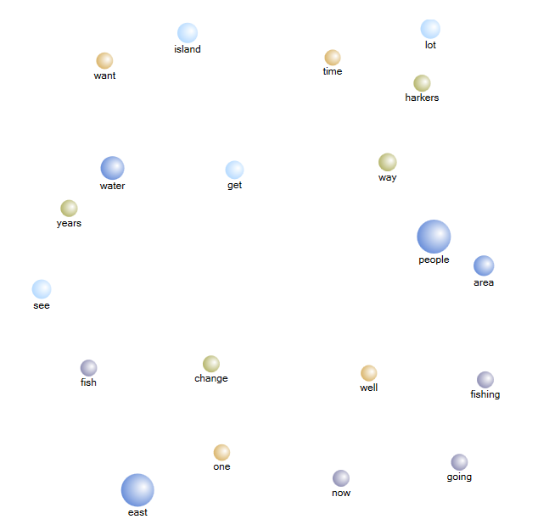
2D Cluster Map
Notes:
A two-dimensional diagram where similar items are clustered together and different items are further apart
A three-dimensional diagram where similar items are clustered together and different items are further apart.
The diagram can be rotated in three dimensions.
The 3D Cluster Map was thus derived from the results of the word frequency query¹, and the words that co-occurred were clustered together. Word frequency was used to determine the size of the bubble in the diagram; bigger bubbles represent words used with greater frequency
¹3D Cluster Maps derived from frequency queries are different to the ones that could be obtained when doing a cluster analysis between different nodes, where the nodes are clustered by word similarity. Therefore, the words contained in the selected nodes are compared. In doing so, nodes that have a higher degree of similarity based on the occurrence and frequency of words are shown clustered together. Nodes that have a lower degree of similarity based on the occurrence and frequency of words are displayed further apart

Slide 71
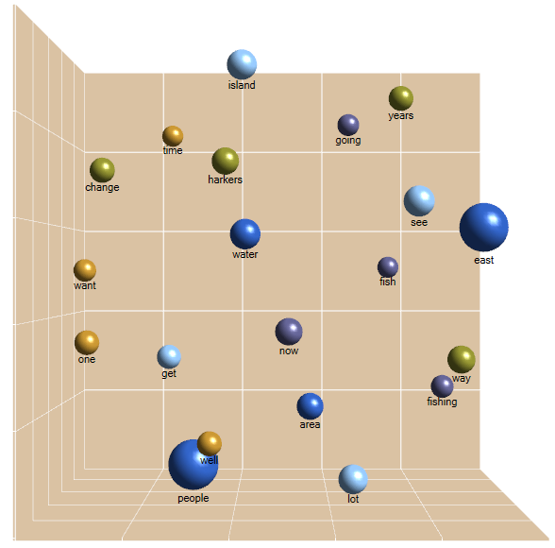
3D Cluster Map
Notes:
A three-dimensional diagram where similar items are clustered together and different items are further apart.
The diagram can be rotated in three dimensions.
The 3D Cluster Map was thus derived from the results of the word frequency query¹, and the words that co-occurred were clustered together. Word frequency was used to determine the size of the bubble in the diagram; bigger bubbles represent words used with greater frequency
¹3D Cluster Maps derived from frequency queries are different to the ones that could be obtained when doing a cluster analysis between different nodes, where the nodes are clustered by word similarity. Therefore, the words contained in the selected nodes are compared. In doing so, nodes that have a higher degree of similarity based on the occurrence and frequency of words are shown clustered together. Nodes that have a lower degree of similarity based on the occurrence and frequency of words are displayed further apart.

Slide 72
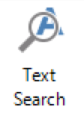
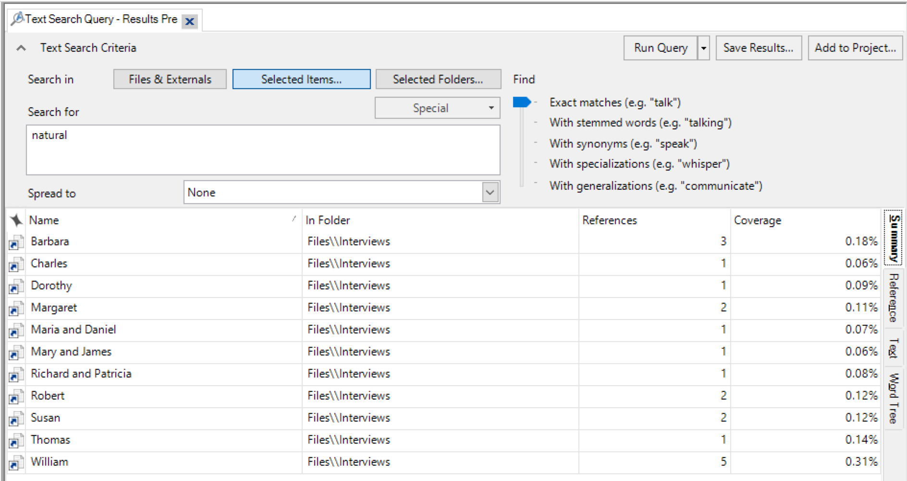
Text search queries

Slide 73
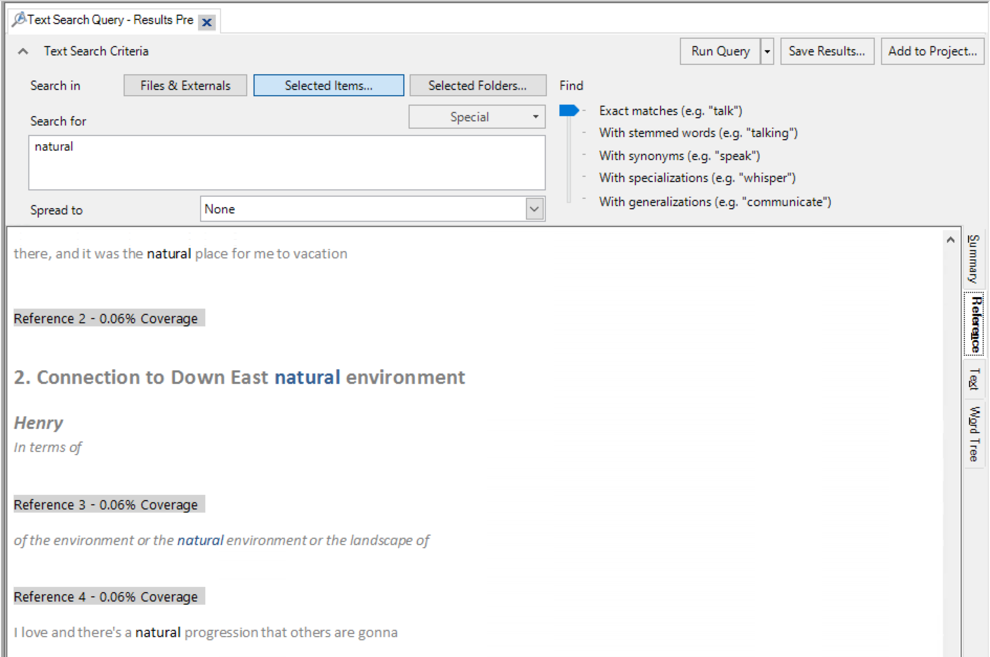
Reference

Slide 74
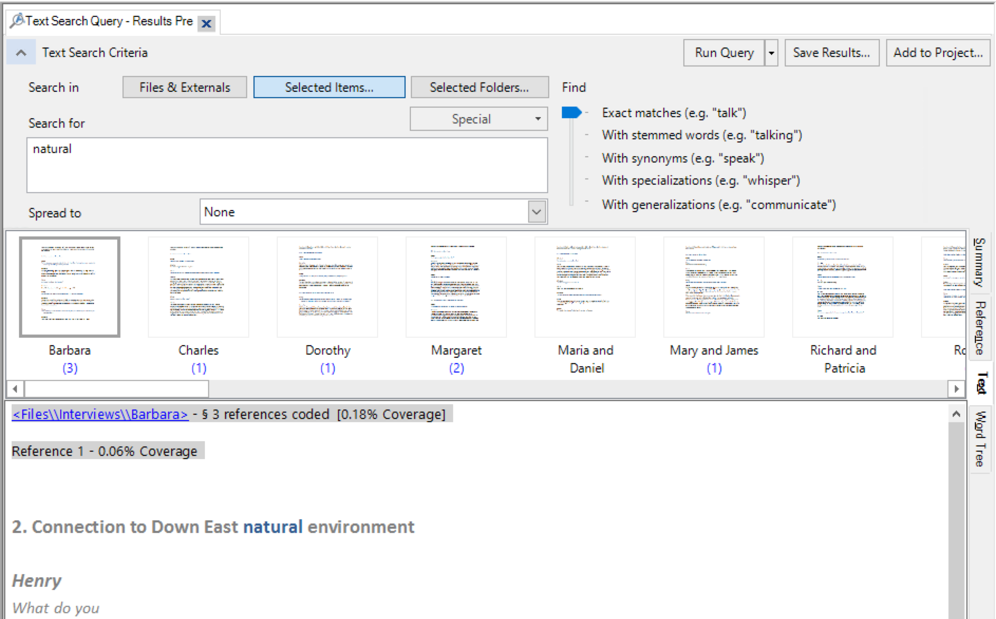
Text

Slide 75
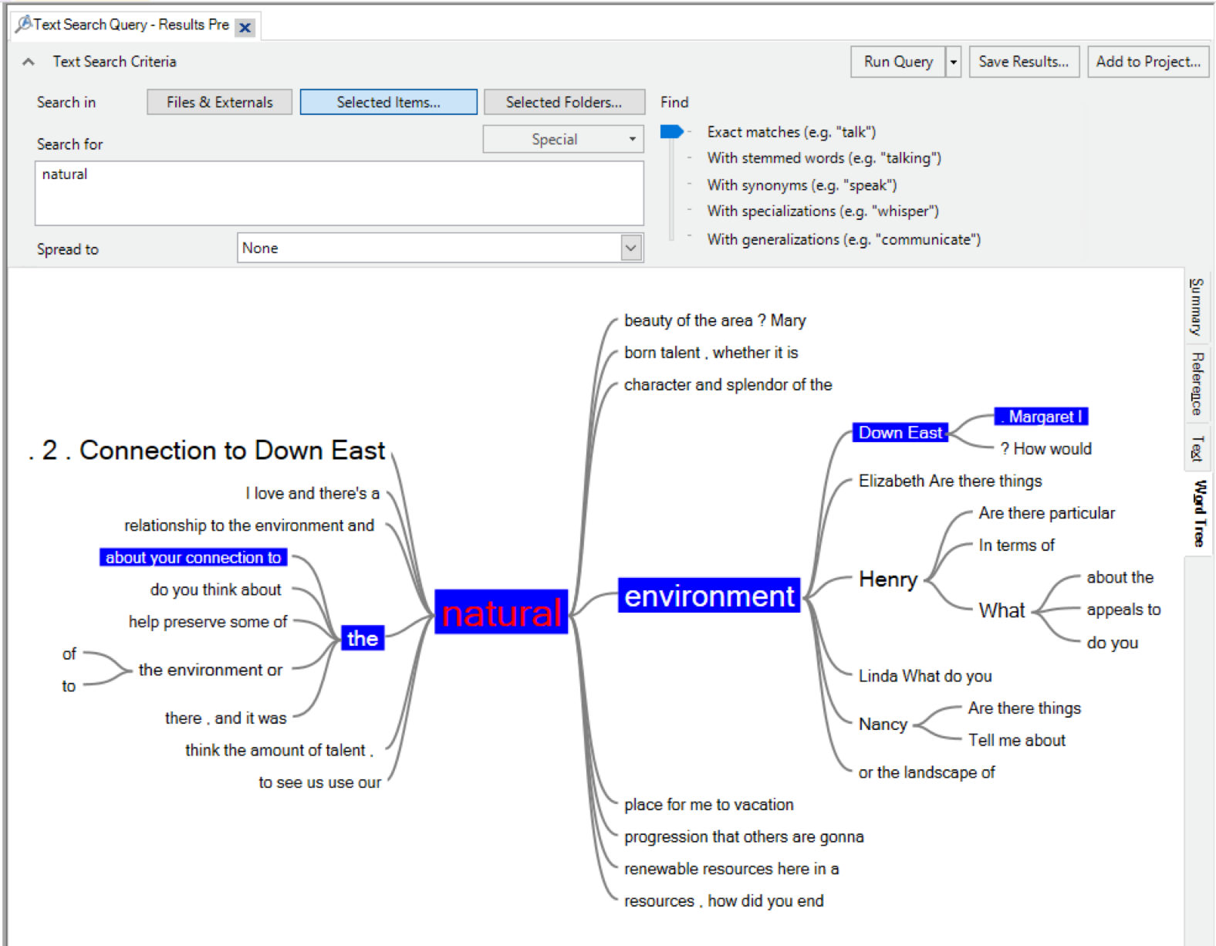
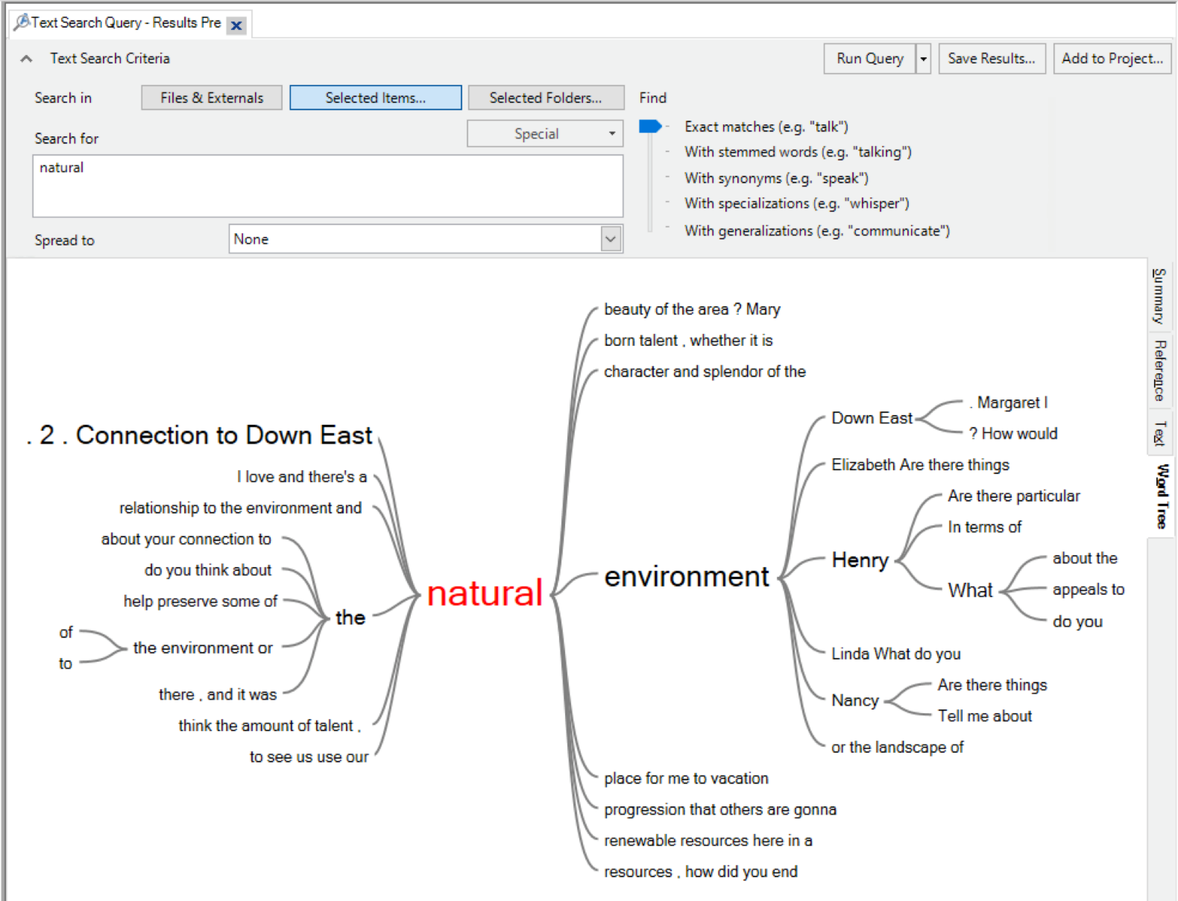
Word tree
Notes:
Text Search Query: search for a word or phrase in your source material and view all the matches in a preview node—automatically code the content (if you want to). Display a word tree to visualize words in context. The word tree allows for you to see the context of a specific word or phrase and allows you to follow the context and see who made each statement.

Slide 76
Match NVivo objects and their descriptions
An action you take on objects to address a question about your data / work with the data.
Reference
Code
Memo
Annotation
Query
A piece of writing that can be standalone or linked to other objects.
A segment of data.
A named concept that can be linked to other objects.
A comment linked to a reference.

Slide 77
Self-reflection
What was the most important thing you learned during this session?
What important question remains unanswered?
Notes:
Annotate or share in the chat

Slide 78




Need Help?
Resources & Consultations
researchcommons.library.ubc.ca
Workshops
elred.library.ubc.ca/libs
Email
research.commons@ubc.ca
researchcommons
@UBCRCommons
UBCResearchCommons

